Slide 1

Drug Life Cycle (Development Stages)
Pharma/Biotech
Pharma/Biotech contracts CROs
IND NDA
Discovery Preclinical Clinical Regulatory Approval Post Mkt Surveillance
Phase 1 Phase 2 Phase 3 Phase 4
IND = Investigational New Drug application
NDA = New Drug Application

Slide 2

UK Regulatory Authorities (Startup Activities)
MHRA HRA NIHR
(Clinical Trial (Ethical Approval & (Funding, Management and Supportive Function
Application via IRAS) Favourable Opinion Via Clinical Research Networks, CRNs)
by Ethics Committee=IEC)
MHRA = Medicines and Healthcare Products Regulatory Authority
HRA = Health Research Authority, have 85 RECs (65 in England, 11 in Scotland, 7 in Wales and 2 RECs in Northern Ireland)
NIHR= National Institute for Health and Care Research (15 CRNs in the UK)
NHS R&D issues Capacity and Capability Confirmation Letter

Slide 3
Assignments
-Therapeutic Area Experience and Expertise
-Oncology
Breast Cancer
Prostate Cancer
Cervical cancer
Diffused B-cell Lymphoma
-Cardiology
Hypertension
Coronary heart disease
-Dermatology
-Gastroenterology

Slide 4
Assignment Continues
Read regulatory authorities in detail, by visiting their websites
Watch the 2nd video that will be sent to WhatsApp

Slide 5
Approval required to open Site
MHRA Initial Approval Letter (and Amendment if AP)
HRA Approval Letter (and Amendment if AP)
REC Initial Approval (Favourable Opinion) Letter (and Amendment if AP)
R&D C&C Confirmation Letter (NHS site)
(Regulatory Documents, filed in ISF (Investigator’s Site File)

Slide 6
Choosing & Conducting Clinical Trial in a site
Feasibility Questionnaire
Site Selection Visit (SSV)
Site Initiation Visit (SIV) and Activation
Routine or Interim Monitoring Visit (RMV or IMV)
Close-out Visit (COV)

Slide 7
Feasibility Questionnaire
Sent to site to complete
CDA (confidentiality disclosure agreement)
Protocol Synopsis
To Understand if site have capacity to perform trial
Assessed by Study team
Proceed to SSV if approved

Slide 8
Site Selection Visit (SSV)
Introduce the study to site personnel
To confirm that site has adequate resources to conduct trial
Facility tour
Collect PI and Sub-I CVs and GCP
Understand patient recruitment numbers
Confirm Staff experience
Write SSV report within 15 working days

Slide 9
Site Initiation Visit (SIV)
Before visit, Collect staff CVs, GCPs, access to EDCs and all plaforms, Clinical Trial Agreement.
Train the study team on Protocol, IB, Pharmacy manual
Study procedure
Laboratory
Pharmacy
Informed consenting procedure
Collect all outstanding documents
Finalise report within 10 working days

Slide 10
Routine or Interim Monitoring Visit (RMV or IMV)
Agreed with site ahead of time and official confirmation Letter sent.
Perform Source Data Verification (SDV)/Source Document Review (SDR)
Confirm Trial is carried out as per Protocol and GCP
Report AE and SAE logs
Review ISF
Report Protocol Deviation (PD) and Noncompliance (NC) logs
Perform IP accountability and reconciliation
Review Lab Kits and expiration
Discuss findings with the PI and study team
Write report within 10 working days
Send follow up letter to site.

Slide 11
Close-out Visit (COV)
Agreed a head of time and official confirmation letter sent
Opposite of Site Initiation Visit (SIV)
Final Reconciliation of IMP, Lab kits and equipments/devices
Pay all outstanding payments
Review ISF
Sign and collect all logs; Site visit, Delegation and Training logs
Shutdown the activities of all vendors
Close all open Action Items and Queries
Meeting with study team and discuss archiving requirement

Slide 12
Key Documents in Trial Filed in ISF and eTMF
Regulatory Documents (Refer to Slide 4)
Protocol
Investigators Brochure
Informed Consent and Patient Information Sheet
Delegation Log
Training Log
Site Visit log
FDA1572/SIF
Staff CVs and GCP Certificates
Others

Slide 13
Protocol
Manual for the Trial
Provided by the Sponsor
Can be amended by submissions to Regulatory Authorities (RA)
Protocol Deviation can happen.
Made up of different sections
Protocol Signature Page (PSP) must be signed by PI b4 trial start
Synopsis or Summary
Study Rationale Section or Background
Objectives and End points
Trial Design and Statistical Analysis
Inclusion and Exclusion Criteria
Schedule of Assessment
Others

Slide 14
Investigators Brochure
Summary highlighting the significant physical, chemical, pharmaceutical, pharmacological, toxicological, pharmacokinetic, metabolic, and clinical information available that is relevant to the stage of clinical development of the investigational product.
A brief introductory/ Background statement on Physical, Chemical, and Pharmaceutical Properties and Formulation
Non-Clinical Studies
Non-clinical Pharmacology
Pharmacokinetics and Product Metabolism in Animals
Toxicology
Effects in Humans
Pharmacokinetics and Product Metabolism in Humans
Safety and Efficacy
Marketing Experience
Summary of Data and Guidance for Investigators
Reference Safety Information for Assessment of Expectedness of Serious Adverse Reactions

Slide 15
Informed Consent and Patient Information Sheet
Has two parts
PARTICIPANT INFORMATION SHEET
Informed consent form for signatures
Explains the study in lay man's language
What is the purpose of the study
Explain any procedure involved in the study
Are there any possible disadvantages or risks from taking part
How long the study will last

Slide 16
Inform Consenting Process
Discussed, explained and reviewed the consent form/assent with subject.
Subject was given adequate time to review the consent form/assent and to discuss participation in this study with family members/others.
All of the subject’s questions were answered/concerns addressed.
Subject did not have any questions/concerns.
The participant has agreed to participate in the study and has signed and dated the informed consent document.
A copy of the signed and dated consent form/assent was given to the subject.
The original signed and dated consent form/assent was placed in the subject records/ISF binder.
Personnel who obtained informed consent is qualified and has been delegated by the Principal Investigator to perform this task

Slide 17
Delegation Log
Has list of site staff partispating in the study
Each personnel must be trained before delegation
All tasks must be delegated
Must have start and end date, countersigned by PI
It is a living document and must be kept up-to-date
To be collected and filed in eTMF as per DMP
Also called Staff Signature and Authority Log

Slide 18
Training Log
Used to record staff training
Living document
Must be kept up-to-date
Filed in ISF and eTMF
Signed by trainer and trainee

Slide 19
Site Visit Log
Completed during the site visit
Countersigned by site staff
Filed in the ISF and eTMF
Evidence of CRA attendance

Slide 20
FDA1572/SIF
Name and address of investigators and sub-i
Education, training, and experience that qualify the investigator as an expert in the clinical investigation of the drug for the use under investigation.
Name and address of any medical school, hospital, or other research facility where the clinical investigation(s) will be conducted
Name and address of any clinical laboratory facilities to be used in the study
Name and address of the IEC that is responsible for review and approval of the study(ies)
Declaration to conduct the study as per GCP and all applicable regulations

Slide 21
Staff CVs and GCP Certificates
CRA collects and file staff CVs and GCP certificates
Normally collected during SSV, before SIV
GCP renewed every 2 years
CVs must be signed and dated
CVs renewed every 3 years
Filed in ISF and eTMF

Slide 22
Other Documents
ISF checklist, a living document
Pre-screening log
Subject screening log
Subject identification log
Subject enrolment log
Investigational products accountability logs
Annual progress report
Financial disclosure form
Clinical trial agreement (CTA)
Email communications
Normal value(s)/range(s) for medical / laboratory / technical procedure(s) and/or test(s) included in the protocol
Medical/laboratory/technical procedures / tests
Sample of label(s) attached to investigational product container(s)
Clinical study report
etc

Slide 23
Types of Events in Clinical Trial
Adverse Event (AE)
Serious Adverse Event (SAE)
Serious Adverse Reaction (SAR)
Suspected Unexpected Serious Adverse Reaction (SUSAR)
Adverse Event of Special Interest (AESI)
Serious Breach
Pregnancy
Protocol Deviation (PD)
Noncompliance (NC)
Quality Issue
CAPA
Action Item (AI)
Query
Audit
Inspection

Slide 24
Adverse Event (AE)
An adverse event (AE) is any untoward medical occurrence in a patient or clinical investigation subject administered a pharmaceutical product and which does not necessarily have a causal relationship with this treatment.
An adverse event can therefore be any unfavourable and unintended sign (including an abnormal laboratory finding), symptom, or disease temporally associated with the use of a medicinal (investigational) product, whether or not related to the medicinal (investigational) product.
Must be reported to sponsor via eCRF and part of Annual Progress report sent to EC
Common Terminology Criteria for Adverse Events (CTCAE)
Grade 1 – Mild: Asymptomatic symptoms. clinical or diagnostic observations only; Intervention not indicated.
Grade 2 – Moderate: Minimal, local or non-invasive intervention was needed
Grade 3 – Severe: Severe symptoms or medically significant but not life-threatening but may be disabling or limit selfcare in Activities of Daily Living (ADL).
Grade 4 - Life-threatening: Urgent or emergent intervention needed
Grade 5 – Death: related to or due to adverse event

Slide 25
Serious Adverse Event (SAE)
A serious adverse event or reaction is an untoward medical occurrence that is considered to represent a significant hazard to the patient. This includes events that result in:
Death
Life-threatening (immediately)
Overnight hospitalisation (initial or prolonged)
Significant loss of function or disability
Congenital malformation/birth defect
Other medically important event*
* Certain adverse events may not necessarily belong to any of these classifications but are still considered medically significant/important and should be considered serious (ie all malignancies and pregnancy).

Slide 26
Serious Adverse Event (SAE) Cont.
Must be reported within 24hr of PI/site being aware of it
Normally reported via eCRF or special SAE form
Initial report must not be complete before reporting
Follow up information could be provided
Followed up till closure

Slide 27
Serious Adverse Reaction (SAR)
An SAE with certain degree of probability that causality is IMP
Regardless of the administered dose
Must be reported within 24hr of PI/site being aware of it
Normally reported via eCRF or special SAE/SAR form
Initial report must not be complete before reporting
Follow up information could be provided
Followed up till closure

Slide 28
Suspected Unexpected Serious Adverse Reaction (SUSAR)
Suspected Unexpected Serious Adverse Reaction is the term used to refer to an adverse event that occurs in a clinical trial subject, which is assessed by the sponsor and or study investigator as being unexpected, serious and as having a reasonable possibility of a causal relationship with the study drug.
The period for reporting SUSARs by the sponsor to Eudravigilance is:
Fatal or life-threatening SUSARs as soon as possible but no later than 7 days after the sponsor become aware of the reaction. The sponsor shall submit a completed report within an additional eight days.
Non-fatal or non-life threatening SUSARs as soon as possible but no later than 15 days after the sponsor become aware of the reaction.
SUSARs initially considered as non-fatal or non-life threatening but turn out to be fatal or life-threatening must be reported as soon as possible but no later than 7 days after the sponsor become aware of the reaction being fatal or life-threatening.

Slide 29
Adverse Event of Special Interest (AESI)
An adverse event of special interest (AESI) (serious or non-serious) is one of scientific and medical concern specific to the sponsor's product or programme, for which ongoing monitoring and rapid communication by the investigator to the sponsor could be appropriate.
May have a special form for reporting
Or reported via eCFR

Slide 30
Serious Breach
A breach that is likely to affect to a significant degree:
the safety or physical integrity of the participants;
or mental integrity of the participants;
or the scientific value of the trial
The breach and follow up with a written notification within 7 days of the Sponsor becoming aware of the breach

Slide 31
Pregnancy in clinical Trial
An exclusion Criteria in clinical trial
Effective Contraception used as per protocol
Regular testing as per protocol
Not an S(AE)
Reported using special form
Conditions during pregnancy can be AE/SAE
Most be followed up by PI till birth and baby infancy

Slide 32
Protocol Deviation (PD)
Any deviation from the protocol
2 types
Minor PD: Doesn’t Increase the risk or decrease the benefit to the patient. Doesn’t significantly affect the subject’s rights, safety or welfare and/or the integrity of the research data.
Major PD/Critical/Important: Increase the risk or decrease the benefit to the patient. Significantly affect the subject’s rights, safety or welfare and/or the integrity of the research data.
Must be recorded in PD log
PD log must be acknowledged and signed and dated by PI

Slide 33
Noncompliance (NC)
Any action or activity associated with the conduct or oversight of research involving human participants that fails to comply with the research plan as approved by Project Team
Or a designated IRB,
Or federal regulations
Or institutional policies governing such research
Must be recorded in non-compliance log
Must be acknowledged, signed and dated by PI

Slide 34
Quality Issues
Data quality issues in clinical trials can be caused by a variety of behaviours including fraud, misconduct, intentional or unintentional noncompliance, and significant carelessness.
Regardless of how these behaviours are defined, they may compromise the validity of the study results.
Reliable study results and quality data are needed to evaluate products for marketing approval and for decisions that are made on the use of medicine.
Early detection of data quality issues are important so that corrective actions taken can be implemented during the conduct of the trial, recurrence can be prevented, and data quality can be preserved.

Slide 35
Corrective Action Preventive Action
CAPA (Corrective and Preventive Action) is a quality system plan which aims to resolve compliance issues and to prevent any further recurrences. A CAPA plan is crucial to a clinical trial as it helps keep trial participants safe and protects their rights. It also prevents the study data from being compromised.
CAPA processes include:
Identifying a potential issue
Identifying the root cause of the issue
Identifying actions to prevent the recurrence of the issue (Corrective Action) and identifying actions to prevent a problem from occurring (Preventive Action)
Documenting that the Corrective and Preventive Actions were carried out
Documenting that the Corrective and Preventive Actions has resolved the issue(s)

Slide 36
Action Item (AI)
Actions required to be taken by CRA or Site personnel to resolve a need
Created by CRA
Mostly after site visit, during report writing
Must be closed once the need is resolved
There is timeline for closing AI
Count as part of CRA metrics

Slide 37
Query
Created in EDC by CRA/DM/system to site, to correct information in EDC
Site to resolve and close the queries in EDC
In a timely Manner
Counts as CRA metrics
CRAs follows up with site personnel to close queries and Ais
During RMV and in-between visit

Slide 38
Note to File (NTF)
Explain gaps or discrepancies in trial processes
Must not be used If gaps/discrepancies can be prevented or eliminated
provide additional information or clarification when other documentation is unavailable or inadequate elsewhere in the research records
Explain clearly and specifically the reason for the error/omission/discrepancy or process/policy it aims to address.
Consider filing an explanation in an email conversation instead of NTF
Last option
Can be used by site or project team (including CRA)
Not a source document
NTF not a panacea (In a Warning Letter dated October 23, 2007)

Slide 39
ALCOACCEA
A= Attributable
L= Legible
C= Contemporaneous
O= Original
A= Accurate
C= Complete
C= Consistent
E= Enduring
A= Available

Slide 40
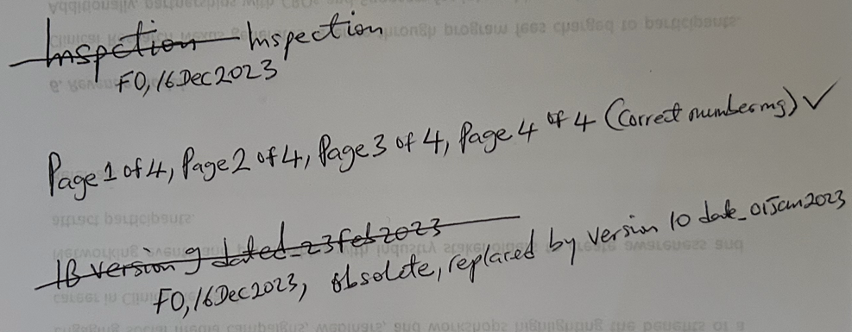
Example of ALCOACCEA practice

Slide 41
Audit
Audit is designed to assess and assure the reliability and integrity of sponsor's trial systems against all relevant written standards.
The sponsor of a clinical trial is responsible for implementing quality systems including the development of an audit plan for the trials they manage.
The auditors are independent individuals appointed by sponsors/regulatory authorities to conduct a systematic and in-depth examination of trial conduct, and compliance with Protocol, SOPs, GCP and the applicable regulatory requirements.
Minor findings
Major findings
Critical findings

Slide 42
Inspection
Conducted by Regulatory Authorities – MHRA
Triggered inspections for serious breaches
A type of Quality Audit
MHRA may contact sponsor/CRO to arrange an inspection if they suspect the law has been broken. This information might come from:
a serious breach notification
a whistleblower
other MHRA departments
the health research authority (HRA)
In rare circumstances, MHRA may give little or no notice of these inspections.
Minor findings
Major findings
Critical findings

Slide 43
Quality Management System
A quality management system (QMS) is a control system for a planned and systematic procedure to maintain or improve quality.
A QMS consists of processes, guidelines and templates that describe the standardized procedure to achieve comparable quality of work results.
A QMS consists of different document types:
Quality Manual: Description of the organization and overview of all processes
SOPs: Work processes and responsibilities
Templates: forms and document templates for data and report entry
Records: data, reports, documents
CTMS- Clinical Trial Management System(CTMS-eTMF)

Slide 44
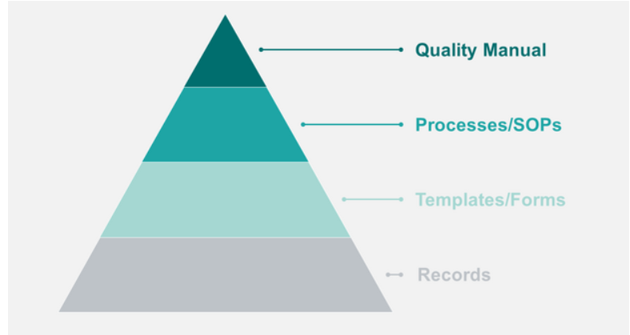
Quality Management System contn

Slide 45
Why do clinical studies need a QMS?
In clinical research, we have a legal obligation to collect traceable data and to produce reproducible results.
In addition, we have a special responsibility to the participating patients.
Guaranteeing the dignity, privacy and safety of study participants is one of the highest principles to which researchers and all their staff are committed.

Slide 46
A QMS helps to achieve the following goals:
Ensure safety & protection of study participants
Ensure quality of study data
Creating an overview and transparency of study activities
Create necessary documentation
Increase efficiency in the conduct of studies
Guarantee compliance with ICH-GCP, local and international laws
To be fit for inspections

Slide 47
QMS Vendors
Veeva Vault: can provide CTMS, eTMF, EDC (electronic Data Capture= both site team and project team have access)
iMeditata: provides EDC
IBM: can provide EDC and IRT (Interactive Response Technology = for IP management and randomisation). IRT interacts with EDC.
Suvoda: provides IRT
4G Clinical: provides IRT
HMD Clinical provides IRT
EPIC: provides EMR (Electronic Medical Record) for Sites, site specific.
Site requires access to EDC and IRT but not CTMS and eTMF.
Site owns the EMR

Slide 48
Common Terminologies in Clinical Trials
Pre-screening = Preliminary assessment of potential patient eligibility
Screened = signed Informed Consent
Screening date = Informed Consent signed date
Screen failed = Signed Informed but did not meet eligibility criteria
Enrolled (Enrolment) = Randomised (Randomisation= Assignment of IMP and enrolment ID to patient)
Data Cut-off = For Interim Data Analysis
Database Lock= EDC locked at end of Study
Patients are Screened and Randomised in IRT and details automatically populated in EDC.

Slide 49
Documentation In Clinical Trial
IF not documented = Not Done

Slide 50
ASSESSMENT: Multiple Choice Questions
Answer all the questions (50) in the attached docx by choosing the correct option or options where applicable. The Pass Mark is 50%.

Slide 51
ASSESSMENT 101 REVIEW: See Correct Answers below.

